Slide 1


Interface and Ambiguity Resolution in C#
C# is a powerful object-oriented programming language. Interfaces and ambiguity resolution are crucial features in designing effective C# code.
Presenter by : Dhiraj Kumar Shah

Slide 2
The Importance of Interfaces
1
2
3
What is an interface?
Why use interfaces?
Best practices for interfaces
An interface is a contract that specifies a set of methods, properties, and events that a class must implement.
Interfaces help create more flexible and maintainable code, as they allow classes to have multiple behaviors and can be used for polymorphism.
Keep interfaces small and modular, using concise and descriptive names for their members. Use abstraction to decouple implementation details.

Slide 3

Type and Ambiguity
1
What is type in C#?
2
What is ambiguity?
Type is a fundamental concept in C# that determines how values are stored and interpreted.
Ambiguity occurs when the C# compiler is uncertain about which type or method to use based on the context or syntax of the code.
3
How to handle ambiguity?
You can use aliases to simplify complex type names and avoid naming conflicts. You can also use explicit casting and fully qualified names to resolve ambiguity.

Slide 4


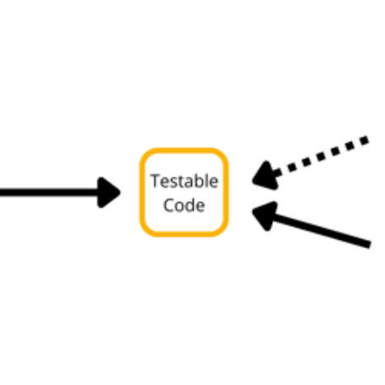
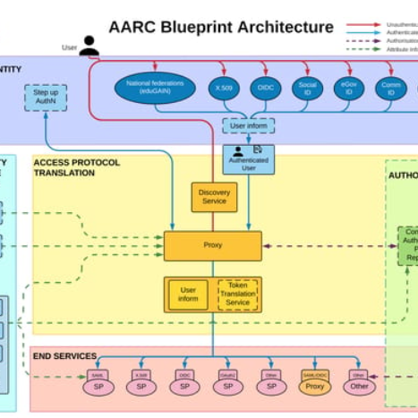
Design Patterns with Interfaces
Abstract Factory
Bridge
Dependency Injection
Facade
Used to create families of related objects without specifying their concrete classes. Clients work with instances of abstract interfaces instead of individual objects.
Separates an abstraction from its implementation so both can evolve independently. Encapsulates the implementation details behind abstract interfaces, allowing the client to switch between different implementations.
Used to create loosely coupled code by providing the dependencies of a class from the outside. Abstract interfaces are used to define these dependencies, allowing for more flexibility, testability, and maintainability.
Used to simplify complex systems by providing a simplified interface to a set of subsystems. Hides the details of the system behind an abstraction, allowing the client to focus on its high-level behavior and use.

Slide 5
Advanced Interface Concepts
Explicit Interface Implementation
Covariance and Contravariance
Default Interfaces Methods
Allows for method implementation in interfaces, reducing boilerplate code and allowing for more expressive interfaces. Requires a default implementation for all implementing classes and can lead to confusion and coupling in large systems.
Allows a class to implement multiple interfaces with the same members, by specifying the interface name before the member name. Prevents name conflicts and allows for more granular control over the implementation.
Allows for variation in the return type of methods (covariance) and the parameters of methods (contravariance), based on the inheritance hierarchy of the interface types. Improves code reusability and readability.

Slide 6
Testing and Debugging Interfaces
1
Unit Testing Interfaces
Allows for isolated testing of interface behavior, separate from its implementation or the system as a whole. Requires careful planning and setup to test all possible scenarios and edge cases.
Debugging Interfaces
2
Requires a good understanding of the interface type and its usage context, as well as advanced debugging tools and techniques. Can be difficult to reproduce and isolate interface-related bugs in large systems.
3
Mocking and Stubbing Interfaces
Used to simulate interface behavior and avoid dependencies on actual implementations or external systems. Requires careful design and setup to provide realistic and consistent test data, and can be time-consuming and costly.

Slide 7
Conclusion
Interfaces and ambiguity resolution are complex topics in C# programming, requiring a solid understanding of type and abstraction concepts, good design principles, and advanced testing and debugging techniques. When used correctly, interfaces can greatly improve the flexibility, maintainability, and scalability of your code.

Slide 8
Example
//Call methode () through an interface reference
public int addA(int a){
A a_obj ;
a_obj=this;
return a_obj.add(a);
}
public int addB(int a){
B b_obj ;
b_obj=this;
return b_obj.add(a);
}
}
public class Program
{
static void Main(string[] args)
{
MyClass ob=new MyClass();
Console.WriteLine("Calling A.add()");
Console.WriteLine(ob.addA(5));
Console.WriteLine("Calling B.add()");
Console.WriteLine(ob.addB(5));
}
}
//Use expliit implementation to remove ambiguity.......
/*@copy right :DKPC2022
*/
namespace _20_Ambiguty;
interface A{
int add(int a);
}
interface B{
int add(int a);
}
//MyClass implements both interfaces...
class MyClass : A,B{
//explicitly implements the two methods()
int A.add(int a){
return a+a;
}
int B.add(int a){
return a*a;
}

